Slide 1
The Urinary/Reproductive System
To better understand the excretory process and how life carries on for generations.

Slide 2
The Urinary System
The excretory system collects the wastes that cells produce and removes them from the body.
The system includes the kidneys, ureters, urinary bladder, and urethra.
The body MUST eliminate excess water and urea.

Slide 3
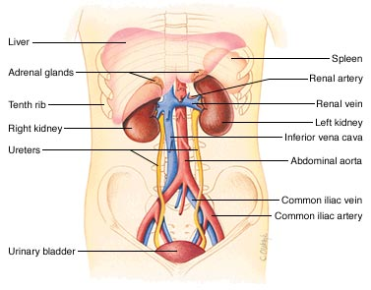

Slide 4
Urea
Urea is a chemical that comes from the break down of proteins.
Urine includes urea, water, and other wastes.
Water-soluble vitamins (B and C) will also be excreted through the urine when your cells have received 100% of their Daily Value.

Slide 5
The Kidney
The two kidneys are the major organs of the excretory (urinary) system.
The kidneys act as a filtering system that help to remove urea and other wastes from the blood, but keep materials that the body needs.

Slide 6
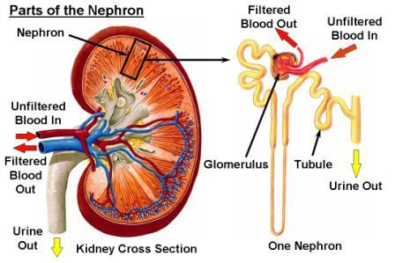
The Kidney
Each kidney has about one million nephrons.
A nephron is a tiny filtering factory that removes wastes from blood and produces urine.

Slide 7
Urine
Once the nephrons have filtered the blood, the wastes are moved through two tubes called, ureters, and urine is brought to the bladder.
The bladder helps to temporarily store the urine (collected, water-soluble waste) until it is excreted through the urethra.

Slide 8
Homeostasis
The ability of an organism to keep internal conditions stable no matter what is happening in the external environment. (KEEP LEVELS IN BALANCE!)
Excretion helps to maintain homeostasis by keeping the body’s internal environment stable and free of harmful levels of chemicals.

Slide 9
Reproductive System
The reproductive system allows for a process called fertilization to happen.
Fertilization requires the joining of an egg cell (female) and a sperm cell (male).
These sex cells are formed, along with hormones, by the ovaries and testes.

Slide 10
Male Reproductive System
The male reproductive system is specialized to produce sperm cells and the hormone testosterone.
The structures include the testes, scrotum, and penis.

Slide 11
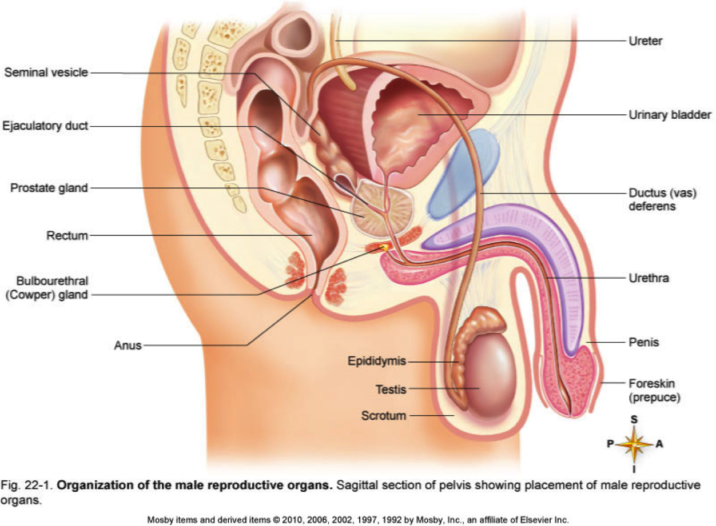

Slide 12
The Testes
The male organ where sperm is produced.
In addition to sperm, the testes produce testosterone.
Testosterone controls the development of adult male characteristics, such as facial hair, deepening of the voice, broadening of the shoulders, and the ability to produce sperm.

Slide 13
The Testes
The tests are located in a pouch of skin called the scrotum.
The scrotum holds the testes away from the rest of the body to keep them about 2-3 degrees Celsius cooler than the normal body temp.
Sperm cannot develop properly at 37 degrees Celsius (98.6 degrees F)

Slide 14
Sperm
The male sex cell that is made up of a head and a tail.
The production of sperm cells begin when a male hits puberty, in the teenage years (11-14).
The head contains genetic information such as blood type.
The tail allows the sperm to swim in fluid.

Slide 15
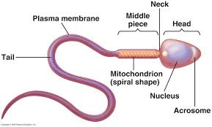

Slide 16
Sperm
After forming in the testes, sperm travel through tubes and mix with fluid to make semen.
The fluids in semen provide an environment where sperm can swim and also contain nutrients that the sperm use for energy.
Semen leaves the body through the urethra, located within the penis. Urine and semen cannot leave the body at the same time.

Slide 17
Female Reproductive System
The female reproductive system is specialized to produce eggs and nourish a developing baby until birth.
It also produces estrogen and other hormones.
The system is made up of the ovaries, uterus, fallopian tubes, vagina, and urethra.

Slide 18
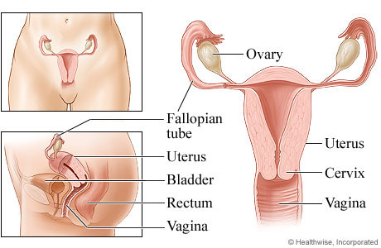

Slide 19
The Ovaries
The female reproductive structures that produce eggs.
The ovaries produce hormones such as, estrogen.
Estrogen triggers the development of adult female characteristics such as, the widening of the hips and the breasts to develop.
Estrogen is also involved in the development of eggs cells.

Slide 20
Ovaries
One of the ovaries releases a mature egg into the nearest Fallopian tube each month.
Fertilization usually occurs in the Fallopian tube.
If the egg is not fertilized, the egg is released through the vagina.

Slide 21
Menstrual Cycle
An egg develops and is released about once a month in a mature woman.
During the menstrual cycle, an egg develops in an ovary. At the same time, the lining of the uterus thickens in a way that prepares the uterus for a fertilized egg.
If the egg is not fertilized, it begins to break down.

Slide 22
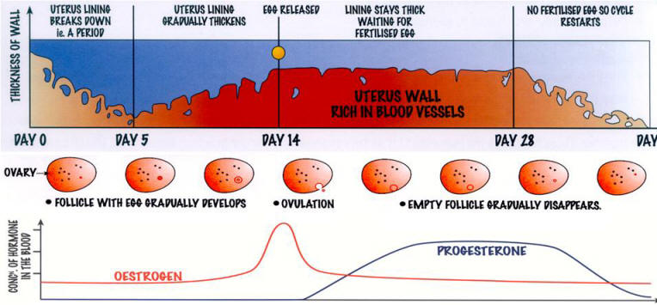

Slide 23
Puberty in Females
Timing of Puberty
Puberty starts at different times and lasts for different periods of time for everyone. It can start as early as 8 years of age to as late as 13 years of age. The sequence of puberty – from breast development to complete physical maturation – may take a year and a half or last as long as 6 years.

Slide 24
Puberty in Females
Puberty Event
Ages at which it happens
Growth of breasts
Growth of pubic hair
Body Growth
First Period
Underarm Hair
Acne
8-13
8-14
9 1/2 – 14 ½
10-16 ½
2 years after pubic hair shows up
Around the same time as under arm hair

Slide 25
Puberty in males
Puberty can begin in males from the ages of 9-14, generally two years after females have already started the changing process
Hormones, ie testosterone, being produced in the testes, begin to be produced which start to cause changes in your body.

Slide 26
Puberty in Males
Puberty Event
Age at which it happens
Growth of testicles & scrotum
Growth of pubic hair
Body Growth
Growth of penis
Change in voice
Facial & Underarm Hair
Acne
10-13 ½
10-15
10 ½-16 ½
11-14 ½
About the same time as penis growth
About 2 years after pubic hair appears.
About the same time as underarm hair appears.

