Slide 1
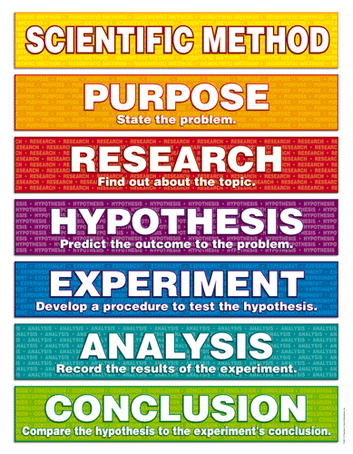
Scientific Method

Slide 2
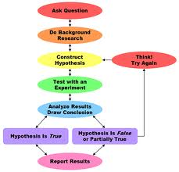
Scientific Method
Series of steps to solve a problem or a question
Solving problems requires organization
There are six steps to follow

Slide 3

Scientific Method
Ask a question or state the problem.

Slide 4
Scientific Method
2. Gather Information or do background research
Use the internet or library resources to research your problem

Slide 5
Hypothesis
3. Construct your hypothesis
Hypothesis-a prediction that can be tested
Can be a possible solution to your problem or question
Must use the words…if…then( if=the cause…then=the effect)

Slide 6
Hypothesis
4. Test the hypothesis
Write a procedure
  Must numbered steps
  No pronouns (I, we, etc.)
  Must be descriptive
  Exact so that any scientist could replicate the steps
Gather materials
Carry out the experiment—need to identify the variables

Slide 7
Variables
Independent Variable—the variable that is being changed in the experiment
    Only ONE factor at a time can change
Dependent Variable—the variable that can be measured, what you are looking to find
Control—the part of the experiment that is kept the same, unchanged

Slide 8
Experiments
Experiments must be done many times to be sure that the independent variable is actually causing the changes
The more experiments performed, the more accurate the results
A controlled experiment only has 1 factor that changes at a time
In an experiment, there needs to be an experimental group and a control group.

Slide 9
DOS
For the following scientific question, identify the independent and dependent variables and control: “Which type of light bulb burns the longest?”
Derek lives in a hot humid cilmate. He has two rose bushes in pots in his yard. The rose bushes grow quickly and bloom large, red roses. Derek moves to a cold, dry climate at the same altitude and notices that his rose bushes stop growing and do not have large blooms. He hypothesizes that the rose bushes are not receiving enough water because he is now in a dry climate. He waters them more often, but they do not improve.
Which of the following scientific questions should he ask next to find out what is wrong with his roses?
A. How much do rose bushes cost in his new area?
B. Do rose bushes grow better in high or low altitudes.
C. Which rose bush has larger, more colorful blooms?
D. Does temperature affect the growth of those rose bushes.

Slide 10
DOS
4. A pH meter will measure how _______ or _______ a substance is.
A. acidic, alkaline
B. alkaline, hot
C. acidic, hot
long, acidic
5. Ken needs to measure out 50 mL of water. Which of the following is the best tool for Ken to use?
A. graduated cylinder
B. Test tube
C. balance
D. beaker

Slide 11
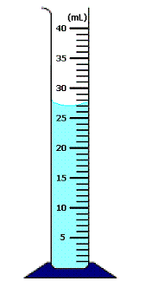
DOS
6. What is the volume of the liquid in the graduated cylinder shown below?
A. 27 mL
B. 27.5 mL
C. 26 mL
D. 28.0 mL

Slide 12
Experiments
Control Group—is the normal way, the group that has nothing changing
  It is used to compare to the experimental group
Experimental Group--is just like the control group BUT has 1 factor that is changing (independent variable)

Slide 13
Analyze Results
5. Analyze your Results--organize the results/data in a clear way to learn what occurred, use charts, tables, graphs to help organize the data
2 kinds of data
  Qualitative (descriptions)
  Quantitative (numbers)

Slide 14
Observations
Qualitative data
  Describes
  Tells the ‘quality’ of the data
  Data that does not have numbers
  Gives physical description…color, shape, size, smell, etc.
Quantitative data
    Numbers
    Give the ‘quantity’—tells how much or how many

Slide 15
Graphing
Step | What to Do | How to Do It
1 | Identify the variables. | Independent Variable (controlled by the experimenter—what is being changed) --Goes on the X axis(horizontal) --Should be on the left side of a data table Dependent Variable(What is being measured) --Goes on the Y axis(vertical) Should be on the right side of a data table

Slide 16
Graphing
Step | What do do | How to do it
2. | Determine the Variable Range. | Subtract the lowest data value from the highest data value. Do each variable seperately.
3 | Determine the Scale of the graph. | Determine a scale (the numerical value for each square), that best fits the range of each variable. Spread the graph to use MOST of the available space.

Slide 17
Graphing
Step | What to do | How to do it
4 | Number and label each axis. | a. This tells what data the lines on your graph represent. Label both the x and y axis.
5 | Plot the data points | Plot each data value on the graph with a dot. You can put the data number by the dot, if it does not clutter your graph.
6 | Draw the graph. | Draw a best fit line. Most graphs of experimental data are not drawn as “connect-the-dots.
7 | Title the graph Your title should clearly tell what the graph is about. Incorporate both variables into the title. | If your graph has more than one set of data, provide a “key” to identify the different lines.

Slide 18
Checkpoint!
Name the six steps of the scientific method.
What is a hypothesis?
Construct a hypothesis for the question, “Will a water filled with balloon burst if exposed to a flame?”
What are the two types of observations?

Slide 19
Checkpoint!
5.
Day | Plant 1 (Control) | Plant 2 (10 mL of water) | Plant 3 (50 mL of water) | Plant 4 (100 mL of water)
1 | 0 cm | .1 cm | 1 cm | .6 cm
2 | .05 cm | .2 cm | .3 cm | .1 cm
3 | .05 cm | .2 cm | .5 cm | .1 cm
4 | 0 cm | .3 cm | 1 cm | 0 cm
5 | .05 cm | .05 cm | .5 cm | .2 cm
6 | 0 cm | .05 cm | .1 cm | .05 cm
7 | 0 cm | 0cm | .2 cm | .05 cm

Slide 20
Quantitative Data
System of measurement in science is called the International System of Units, or SI
Length
  1 meter=100 cm=1000 mm
  1 km=1000 m
Volume
  1 L=1000 mL
Mass
  1 kilogram(kg)=1000 grams(g)
  1 gram=1000 milligram

Slide 21
Conversions
King Henry Danced Merrily During Christmas Morning

Slide 22
Conclusions
6. Draw Conclusions--do the results support the hypothesis?
It is OK if the hypothesis is wrong, if wrong it usually leads to new questions being asked and in turn leads to new experiments
Communicate your results, orally or written, to the science community

