Slide 1
The Respiratory System
Unit 3
State Standard C16

Slide 2
Unit Objectives for all Students
Students will be able to describe the structures of the respiratory system
Students will be able to explain how these structures bring oxygen and nutrients to the cells
Students will be able to identify and describe the effects of smoking on lung capacity and the destruction that it causes to the respiratory system

Slide 3
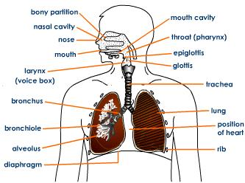
Respiratory System

Slide 4
Purpose of the Respiratory System
To deliver oxygen to our blood, which brings the oxygen to the cells throughout the body
To remove waste products, such as CO2

Slide 5
Respiration
Internal ______________ occurs at the cellular level—the ______________ utilizes the O₂ we breathe in through the respiratory system
C₆H₁₂O₆ + 6O₂ ➔ 6CO₂ + 6H₂O +______(energy)
_________ + ______ ➔ carbon dioxide + water +energy

Slide 6
Cellular Respiration
C₆H₁₂O₆ + 6O₂ ➔ 6CO₂ + 6H₂O +______(energy)
_________ + ______ ➔ carbon dioxide + water +energy
The exchange of O₂ at the ___________ into the blood allows the respiration process to occur and supplies energy for you.
Blood, part of the ____________ system, carries the oxygen from the respiratory system and glucose from the ___________ system to the body cells for respiration to occur.

Slide 7
The Diaphragm
The ______________ is a muscle that is controlled by the _____ (autonomic nervous system)
The diaphragm’s movement is ___________ and programmed by your _______
This muscle __________ and _________ to help move gasses into and out of the __________.

Slide 8
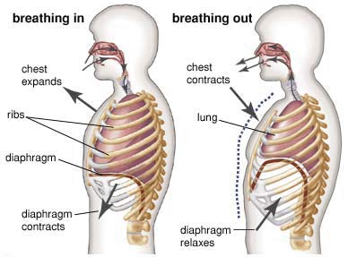
The Diaphragm

Slide 9
The Diaphragm
When ___________, the diaphragm _________ and creates ________ pressure within the lungs
Air will always move from an area of ________ pressure, to an area of __________ pressure
Because of the low pressure within the lungs, air ________________.
As diaphragm relaxes, or moves back into position, air is pushed back out of the lungs.

Slide 10
The Respiratory System
_________ Respiratory System
________ Respiratory system
The nose and nasal cavity
Mouth and oral cavity
Pharynx
___________
__________
Bronchi
Lungs
_______________
____________
Diaphragm

Slide 11
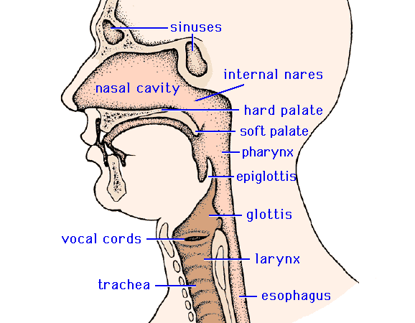
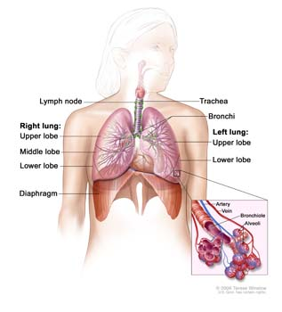

Slide 12
The Nose and Nasal Cavity
Air enters through the mouth or nose
________ in the nostrils trap _____ from the air
When air passes through the nasal cavity, it is ____________ and __________.
This allows for a deeper, fuller breath so more __________ gets into the __________.
Mucus helps to trap dust, _________, and other materials

Slide 13
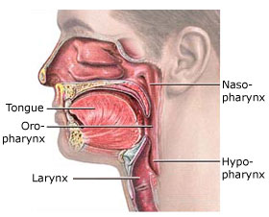
The Pharynx
The warmed, moist air enters the ___________, which is at the very back of your throat
At the lower end of the pharynx, a flap of ________ called the ____________ helps cover the trachea while eating or drinking
If you begin to choke…what just happened?

Slide 14
The Larynx
The airway to which your ______________are attached.
Piece of ___________ which protects the vocal cords and connects the __________ and ____________.
Forcing air between the two cords cause them to vibrate and produce sounds

Slide 15
The Trachea
Also known as the, “______________”
The trachea is surrounded by strong, C-shaped rings of ___________ to prevent the trachea from ____________
It is lined with ________ and _______ that trap dust, bacteria, and pollen
Cilia are tiny, ______________________that line the trachea

Slide 16
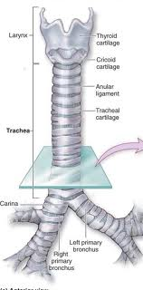

Slide 17
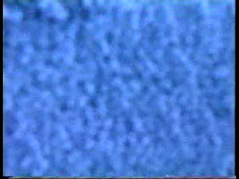

Slide 18
The Bronchi
Trachea divides into _____ short tubes called, the __________
The _________ ___________ connect directly to the lungs.
The bronchi branch into smaller and smaller tubes, the smallest called, _______________.

Slide 19
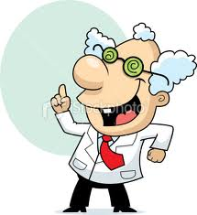
FACT!
During one minute, while the body is at rest, approximately 12.5 ml of oxygen per kg of body weight are used by body cells; an equal amount of carbon dioxide is produced!
95 LB male = 43.2 kg
12.5 ml x 43.2 kg = 540 ml of O₂ per minute!

Slide 20
Alveoli
At the end of each _____________ are clusters of tiny, thin-walled sacs called, alveoli
The ___________ are surrounded by ____________.
Capillaries are extremely tiny ______________ that have a very thin membrane—they are so tiny, _____________________ must travel in a single-file line.
Capillaries surround your organs and connect arteries and veins.

Slide 21
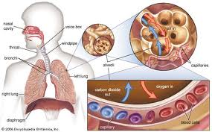

Slide 22
Gas Exchange at the Alveoli
Exchange of ______________takes place between the _________ and capillaries
The O₂ moves from the alveoli into the capillary and is picked up by _____________.
Hemoglobin is a molecule in red blood cells.
O₂ is then carried to all ________________ to be combined with ____________ inside the ________________.

Slide 23
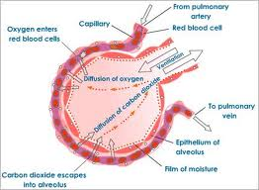

Slide 24
Gas Exchange at the Alveoli
At the same time, _____ (along with other waste) are being __________ from the body cells.
The CO₂ moves through the cell membrane and into the ____________ and are are carried by the blood to the lungs.
At the alveoli, the CO₂ is moved out of the capillaries and through the cell membrane of the alveoli.
The waste gases, mainly CO₂, leave the body during ____________.

Slide 25
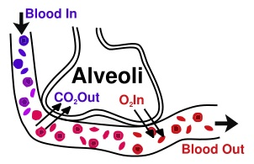

Slide 26
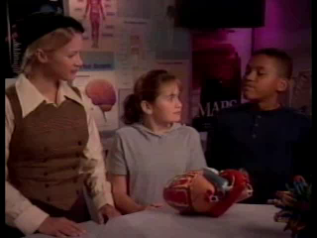

Slide 27
Lung Capacity
Total Lung Capacity--the amount of air in the lungs after a deep inhalation
TIDAL LUNG CAPACITY – The amount of air your lungs hold during normal breathing; the amount of air moved in and out of the body in one breath
Lung volumes differ with age, sex, body frame and aerobic fitness.
Many conditions, diseases, and factors can also affect lung capacity.

Slide 28
Asthma
Asthma is a __________ disease of the airways of the lungs
When the ________ become inflamed, _______ can also plug the airways, ____________ airflow
Asthma causes recurring periods of _________, chest tightness, _____________________, and ____________.
The coughing often occurs at _________ or early in the morning.

Slide 29
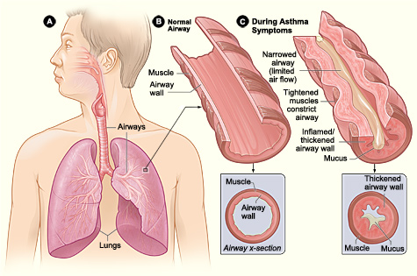

Slide 30
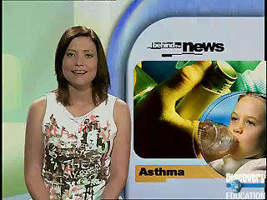

Slide 31
Asthma
Attack caused by a “_________”—can be an allergic reaction, ___________, stress, _________________, etc.
Bronchial tubes ___________ (close up) because of intense ___________________ contractions inside the tubes
Inhaler’s help to ________ the muscles in the ____________________

Slide 32
Respiratory System Discorders
Bronchitis—____________ of the __________ tubes.
  Can be “acute” (_________________________) or “chronic” (_________________).
  Excessive __________ is produced and the infection is in the main airways to your lungs.
  In order to be chronic ________________, you must have a cough with _____________________for most days of the month for ___ or more months.
  Many times chronic bronchitis is a result from ______________.

Slide 33
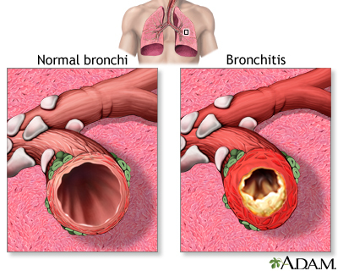

Slide 34
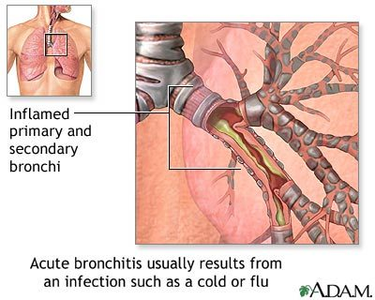

Slide 35
Pneumonia
Pneumonia is a breathing (_____________) condition in which there is an ____________ of the lung.
Caused when __________ or __________ are spread from your nose, nasal cavity or sinuses into your _______.
Recent _________, laryngitis, ____, or bronchitis can cause pneumonia.
Alveoli are coated with excessive mucus causing….

Slide 36
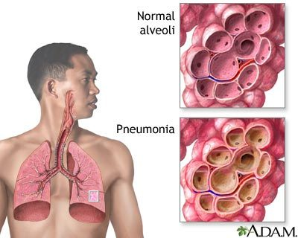

Slide 37
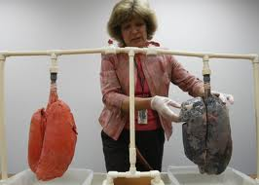
Smoking

Slide 38
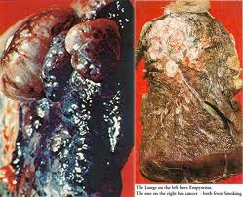

Slide 39
