Slide 1
The Respiratory System
Unit 3
State Standard C16

Slide 2
Unit Objectives for all Students
Students will be able to describe the structures of the respiratory system
Students will be able to explain how these structures bring oxygen and nutrients to the cells
Students will be able to identify and describe the effects of smoking on lung capacity and the destruction that it causes to the respiratory system

Slide 3
Cell to System
All living things are made up of cells, which are the most basic unit of life.
Cell→tissue→organ→organ system→organism

Slide 4
Level 1—Cells Are the basic unit of structure and function in living things. May serve a specific within the organism Examples—blood cells, nerve cells, bone cells, etc. | Level 2-Tissues Made up of cells that are similar in structure and function and work together to perform a specific activity. Examples—blood, nervous, bone, etc. Humans have 4 basic tissues: connective, epithelial, muscle, and nerve.
Level 3—Organs Made up of tissues that work together to perform a specific activity. Examples—heart, brain, skin, lungs, etc. | Level 4—Organ Systems Groups of two or more tissues that work together to perform a specific function for the organism. Examples—circulatory system, respiratory system, digestive system, etc. The human body has 11 organ systems!

Slide 5
Level 5--Organism
Entire living things that can carry out all basic life processes. Meaning they can take in materials, release energy from food, release wastes, grow, respond to the environment, and reproduce.
Usually made up of organ systems, but an organism may be made up of only one cell such as bacteria
Examples—bacteria, mushroom, sunflower, human.

Slide 6
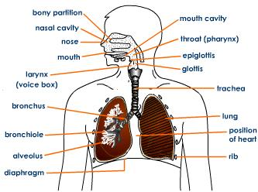
Respiratory System

Slide 7
Purpose of the Respiratory System
To deliver oxygen to our blood, which brings the oxygen to the cells in throughout the body
To remove waste products, such as CO2

Slide 8
Respiration
Internal respiration occurs at the cellular level—the mitochondria utilizes the O2 we breathe in through the respiratory system
C₆H₁₂O₆ + 6O₂ ➔ 6CO₂ + 6H₂O +ATP(energy)
Glucose + oxygen ➔ carbon dioxide + water + energy

Slide 9
Cellular Respiration
C₆H₁₂O₆ + 6O₂ ➔ 6CO₂ + 6H₂O + ATP(energy)
Glucose (sugar)+ oxygen➔ carbon dioxide + water +energy
Blood, part of the circulatory system, carries the oxygen from the respiratory system and glucose from the digestive system to the body cells for respiration to occur.
The exchange of O₂ at the alveoli into the blood allows the respiration process to occur and supplies energy for you.

Slide 10
The Diaphragm
The diaphragm is a muscle that is controlled by the ANS (autonomic nervous system)
The diaphragm’s movement is automatic and programmed by your brain
This muscle contracts and relaxes to help move gases into and out of the lungs

Slide 11
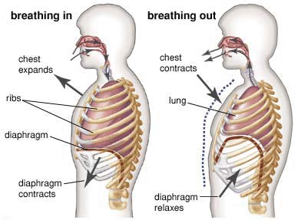
The Diaphragm

Slide 12
The Diaphragm
When contracted, the diaphragm flattens and creates lower pressure within the lungs
Air will always move from an area of higher pressure, to an area of lower pressure
Because of the low pressure within the lungs, air rushes into the lungs
As diaphragm relaxes, or moves back into position, air is pushed back out of the lungs

Slide 13
The Respiratory System
Upper Respiratory System
Lower Respiratory system
The nose and nasal cavity
Pharynx
Larynx
Trachea
Bronchi
Lungs
Bronchioles
Alveoli
Diaphragm

Slide 14
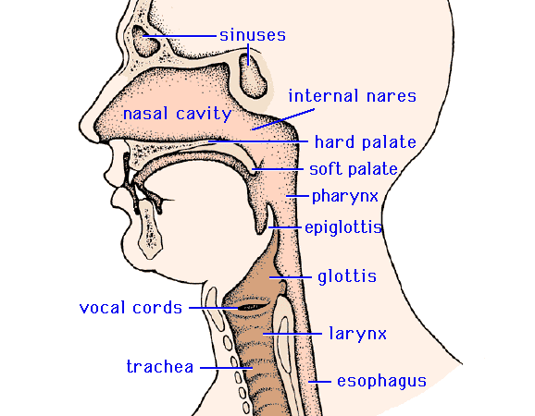
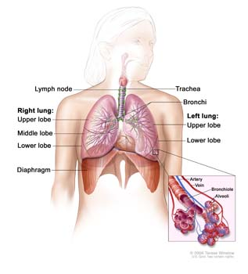

Slide 15
The Nose and Nasal Cavity
Air enters through the mouth or nose
Hairs in the nostrils trap dust from the air.
The nasal cavity is lined with many capillaries.
When air passes through the nasal cavity, it is moistened and warmed.
This allows for a deeper, fuller breath so more oxygen gets into the lungs
Mucus helps to trap dust, pollen, and other materials

Slide 16
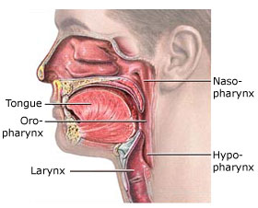
The Pharynx
The warmed, moist air enters the pharynx, which is at the very back of your throat
At the lower end of the pharynx, a flap of tissue called the epiglottis helps cover the trachea while eating or drinking
If you begin to choke…what just happened?

Slide 17
The Larynx
The airway to which your vocal cords are attached.
Piece of cartilage which protects the vocal cords and connects the pharynx and trachea.
Forcing air between the two cords cause them to vibrate and produce sounds

Slide 18
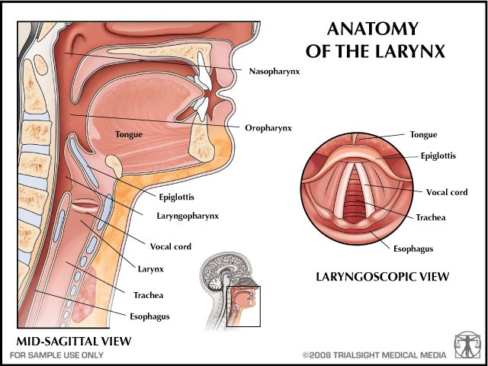

Slide 19
The Trachea
Also known as the, “windpipe”
The trachea is surrounded by strong, C-shaped rings of cartilage to prevent the trachea from collapsing
It is lined with mucus and cilia that trap dust, bacteria, and pollen
Cilia are tiny, hair-like structures that line the trachea

Slide 20
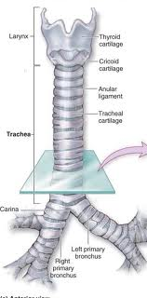

Slide 21
Mucociliary Escalator
The mucociliary escalator is located in the trachea, bronchi, and nose.
It is composed of two basic parts:
  Mucus producing cells
  Ciliated epithelium
Cilia are constantly beating
Very important barrier against getting sick.
Smoking paralyzes the moving cilia.

Slide 22
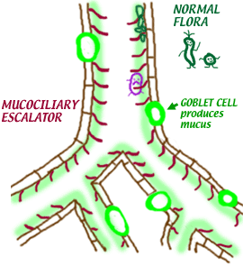

Slide 23
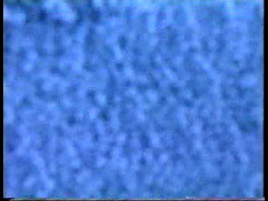

Slide 24
The Bronchial Tree
Trachea divides into two short tubes called the left and right main bronchus (singular)
The primary bronchi (plural) connect directly to the lungs
Inside the lungs, there are a secondary and tertiary sets of the bronchi
The bronchi branch into smaller and smaller tubes, the smallest called, bronchioles, which are the thinnest and most delicate branches.

Slide 25
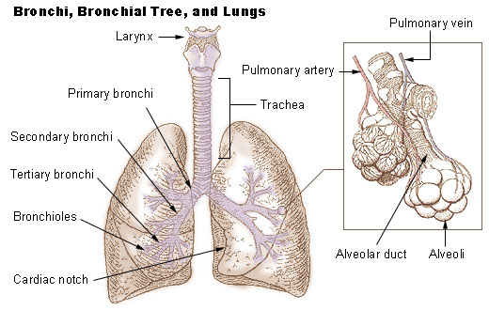

Slide 26
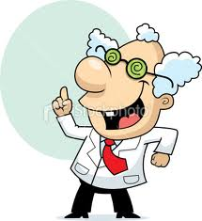
FACT!
During one minute, while the body is at rest, approximately 12.5 ml of oxygen per kg of body weight are used by body cells; an equal amount of carbon dioxide is produced!
195 LB male = 88.64 kg
12.5 ml x 88.64 kg = 1108 ml of O₂ per minute!
Calculate the amount of oxygen are used by your cells!

Slide 27
Alveoli
At the end of each bronchiole are clusters of tiny, thin-walled sacs called, alveoli
The alveoli are surrounded by capillaries
Capillaries are extremely tiny blood vessels that have a very thin membrane—they are so tiny, red blood cells must travel in a single-file line.
Capillaries surround your organs and connect arteries and veins.

Slide 28
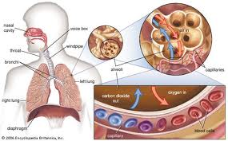

Slide 29
Gas Exchange at the Alveoli
Exchange of O₂ and CO₂ takes place between the alveoli and capillaries
The O₂ moves from the alveoli into the capillary and is picked up by hemoglobin
Hemoglobin is a molecule in RBCs
O₂ is then carried to all body cells to be combined with glucose inside the mitochondria

Slide 30
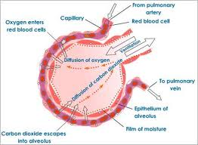

Slide 31
Gas Exchange at the Alveoli
At the same time, CO2 (along with other waste) are being removed from the body cells
The CO2 moves through the cell membrane and into the capillaries and are are carried by the blood to the lungs
At the alveoli, the CO2 is moved out of the capillaries and through the cell membrane of the alveoli
The waste gases, mainly CO2, leave the body during exhalation

Slide 32
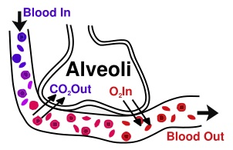

Slide 33
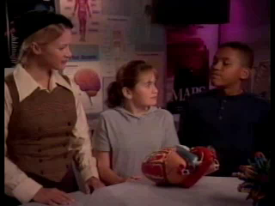

Slide 34
Lung Capacity
Total Lung Capacity--the amount of air in the lungs after a deep inhalation
TIDAL LUNG CAPACITY – The amount of air your lungs hold during normal breathing; the amount of air moved in and out of the body in one breath
Lung volumes differ with age, sex, body frame and aerobic fitness.
Many conditions, diseases, and factors can also affect lung capacity.

Slide 35
Asthma
Asthma is a chronic disease of the airways of the lungs
When the tissues become inflamed, mucus can also plug the airways, decreasing airflow
Asthma causes recurring periods of wheezing, chest tightness, shortness of breath, and coughing.
The coughing often occurs at night or early in the morning.

Slide 36
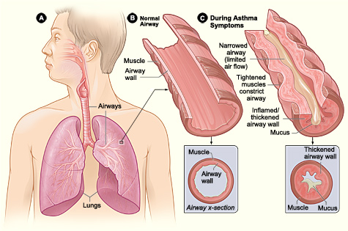

Slide 37
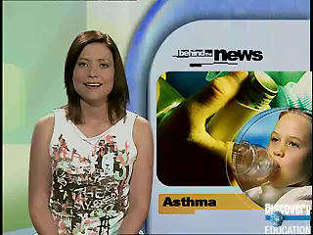

Slide 38
Asthma
Attack caused by a “trigger”—can be an allergic reaction, cold weather, stress, cigarette smoke, etc.
Broncial tubes constrict (close up) because of intense smooth muscle contractions inside the tubes
Inhaler’s help to relax the muscles in the bronchial tubes

Slide 39
Laryngitis
The ending “-it is” means inflammation.
Laryngitis is inflammation of the larynx, which causes the swelling of the vocal cords which disrupts the ability of the cords to produce sound.
Most cases last up to a week at the most, but if the a bacterial infection spreads to the epiglottis, which can cause swelling that can cause suffocation.

Slide 40
Respiratory System Disorders
Bronchitis—inflammation of the bronchi tubes.
  Can be “acute” (short-lived infection) or “chronic” (long lasting).
  Excessive mucus is produced and the infection is in the main airways to your lungs.
  In order to be chronic bronchitis you must have a cough with excessive mucus for most days of the month for 3 or more months.
  Many times chronic bronchitis is a result from smoking.

Slide 41
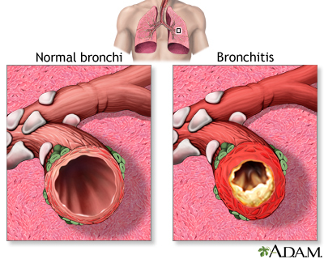

Slide 42
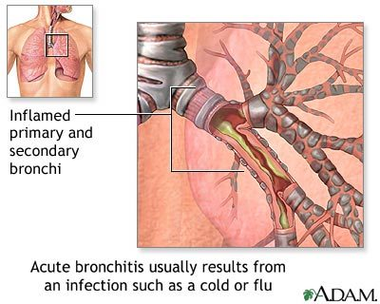

Slide 43
Pneumonia
Pneumonia is a breathing (respiratory) condition in which there is an infection of the lung.
Caused when bacteria or viruses are spread from your nose, nasal cavity or sinuses into your lungs.
Recent cold, laryngitis, flu, or bronchitis can cause pneumonia.
Fluids leak into the alveoli and the broncioles swell and constrict.

Slide 44
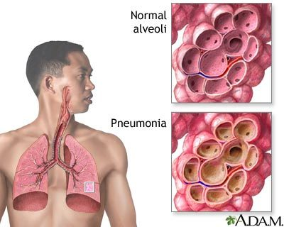

Slide 45
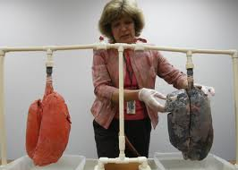
Smoking

Slide 46
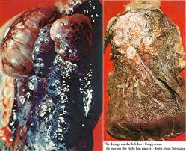

Slide 47
