Slide 1
The Digestive System

Slide 2
The Digestive System
Hungry Anyone?

Slide 3
Digestion
The process of ______________food into small ___________ so that they can be ____________ into the blood.
Digestive Tract organs involved:
  Mouth—teeth and tongue
  ____________
  Stomach
  ________________
  Rectum and anus

Slide 4
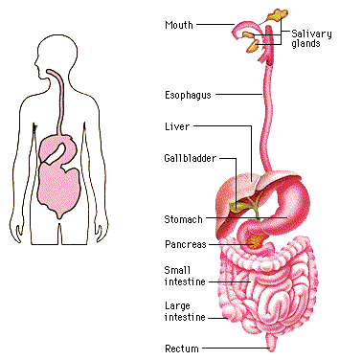
The Digestive System

Slide 5
Digestion
Two types of digestion:
Mechanical digestion—__________________________________________________________________________ There is no breaking of any chemical bonds!
Chemical Digestion—__________________________________________________________________________

Slide 6
Digestion
“Goals” of chemical digestion:
  Carbohydrates➔monosaccarides (_________)
  Protein➔______________
  Fat➔fatty acids
Absorption—the ____________ of nutrients (glucose, amino acids, fatty acids) from the gut into the ____________

Slide 7
Fun Facts
Chewing food takes from 5-30 seconds
Swallowing takes about 10 seconds
Food sloshing in the stomach can last 3-4 hours
It takes 3 hours for food to move through the intestine
Food drying up and hanging out in the large intestine can last 18 hours to 2 days!

Slide 8
Fun Facts
Americans eat about 700 million pounds of peanut butter.
Americans eat over 2 billion pounds of chocolate a year.
In your lifetime, your digestive system may handle about 50 tons of food!!

Slide 9
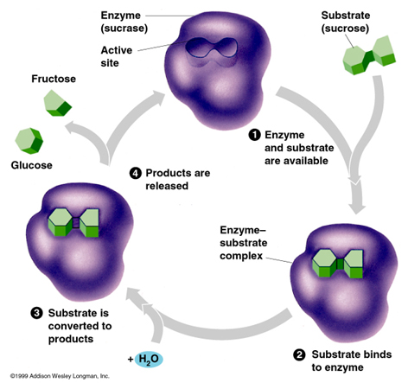
Enzymes in Digestion
Chemical digestion happens because of enzymes
Enzyme—_________
_________________________________________________________.

Slide 10
Enzymes in Digestion
Amylase—an enzyme produced by ________ near the _________
  Breaks down complex carbohydrates (pasta, whole grain breads) into _________________(glucose).
___________—an enzyme that is produced in your ___________
  Helps in the chemical reactions that break down proteins.
Many other enzymes secreted by the pancreas that help to break down proteins, carbs, and fats.

Slide 11
Checkpoint!
How long is the small intestine?
  12 feet
  40 feet
  10 feet
  25 feet
2. Name three organs involved in digestion.

Slide 12
Checkpoint!
Chewing a piece of steak is an example of ____________.
  Chemical digestion
  Mechanical digestion
  Absorption
  None of the above.
4. Chemical digestion includes breaking ________ and using __________ to break down food.
A. chemical bonds, enzymes
B. Food particles, enzymes
C. Glucose, protein

Slide 13
Checkpoint!
Proteins are broken down into _________ before they can be absorbed.
A. Sugars
B. Fatty acids
C. Amino acids
D. Glucose
The enzyme produced in the mouth to break down carbohydrates.
A. Pepsin
B. Amylase
C. Lipase
D. Trypsin

Slide 14
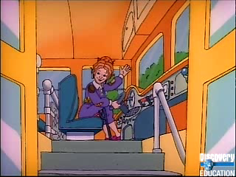

Slide 15
The Mouth
_______—purpose is to rip, grind, and mash food so it fits down our esophagus
Tongue—pushes food around mouth to make chewing and swallowing easier
_______________—deliver saliva to the mouth. This fluid contains pancreatic enzymes to start breaking down carbohydrates.

Slide 16
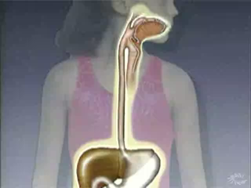
Esophagus
A muscular canal running from the ________ to the stomach.
Peristalsis is the name used to describe the _______ and ________ actions of this muscle to push food down into the stomach.

Slide 17
Stomach
Muscular “____” to store, mix, digest, and empty food
_________ digestion: peristaltic waves contract throughout the stomach to ___ and _______ food
__________ digestion: specialized cells in the walls of the stomach secrete___________
HCl also helps to destroy ________ in food

Slide 18
Stomach
Stomach also produces ______ which makes food slippery and ________ the stomach
Two _________ to help keep contents inside stomach
  _____________ sphincter—top of stomach
  ______ sphincter—bottom of stomach
By the time food moves through your stomach, it is turned into a thin, watery liquid called_________

Slide 19
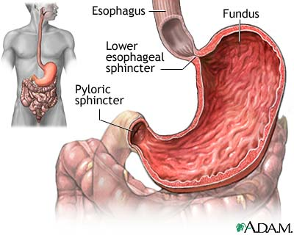

Slide 20
Small Intestine
First part of small intestine is called___________—most digestion takes place here
Bile from your ________ is added into the duodenum
Acid from your stomach makes fat particles float to the top of the chyme
Bile _______ up the large ____ particles to help begin digesting the fats

Slide 21
Small Intestine
________ digestion of carbs, proteins, and fats occurs when digestive solution from the __________ is mixed in
The solution contains ________ and also bicarbonate to help ________ the stomach acid.
__________ takes place in the ______ of the small intestine

Slide 22
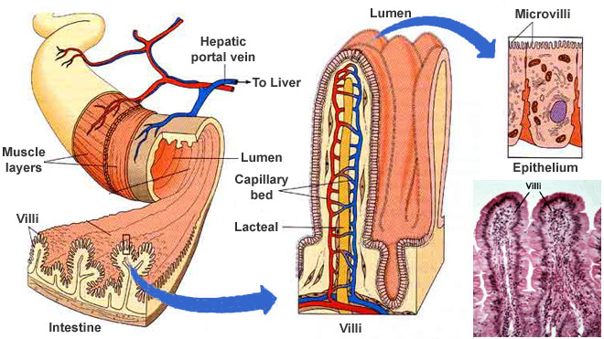

Slide 23
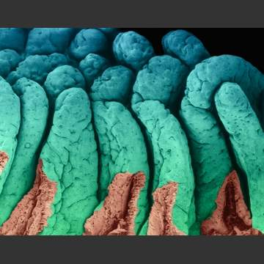

Slide 24
Small Intestine
___________ are within the villi of the small intestine
Nutrients (_________, fructose, galactose,___________, and fatty acids) move into the blood through_________
_______CONCENTRATION TO _________ CONCENTRATION
The blood transports all the _________ from the small intestine to the cells of your body

Slide 25
Large Intestine
Main job of the large intestine is to _______ water from the __________ mass
This helps to keep our body___________
The __________ in your large intestine feed on undigested material and make vitamin __ and two types of ___ vitamins
The dried up, undigested mass leaves the body through the _______ and______

Slide 26
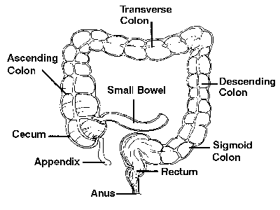

Slide 27
Liver in Digestion
The liver produces ___________which is then stored and made stronger in the___________.
The bile is sent to the ___________through a duct (_________________)
Bile ____________fats (___________it into small droplets) so they can mix with ______ and be acted upon by____________.

Slide 28
Pancreas in Digestion
Pancreas produces ________________ which empties into the ________________through a duct.
The ____________ also produces __________ to help regulate blood ___________ levels.

Slide 29
Pancreatic Juice
Contains___________________, which neutralizes the _________ material from the__________.
Pancreatic ___________ digests starches (starts in the_________)
__________ and ___________ digest proteins—they are specific for certain proteins.
__________ digests fats

Slide 30
Nutrition
____________ are substances in foods that provide _________ and materials for cell _____________, ________, and_________.
Look for foods that are _________________—foods that give you the nutrients you need with fewer___________.
  Skinless, baked chicken vs fried chicken
  Fresh fruit vs fruit juice or fruit pastry

Slide 31
Energy Needs
Body needs energy for every activity it performs—beating_________, blinking your eyes,____________, etc.
Energy comes from the food we eat—this energy is measured in___________.
Different foods contain different amounts of calories

Slide 32
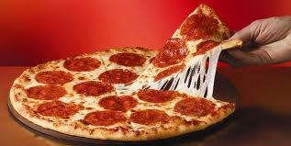
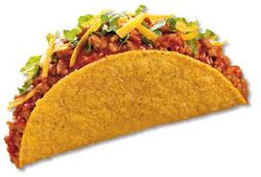
Caloric Content?
280 calories, 16 g PRO
186 calories, 15 g PRO

Slide 33
Checkpoint!
The liver produces ____________.
A. Pepsin
B. Pancreatic Juice
C. Bile
D. Kidney stones
2) Bile is sent through the ___________ to the _____________.

Slide 34
Checkpoint!
3) Pancreatic juice contains __________ to help neutralize acids from the stomach.
4) _________ is an enzyme from the pancreas that digests carbohydrates in the mouth.
5) This enzyme digests fats.
6) What is the job of bile? Where is it produced? Where is it stored?

Slide 35
Checkpoint!
7) What other function does the pancreas serve besides secreting pancreatic juice into the small intestine?
8) What are the two functions (jobs) of the large intestine?

Slide 36
Proteins
Large ____________ that contain _________, hydrogen, ___________, and nitrogen.
Made up of a number of small units, called _______________.
Body contains __________________—9 of which are _____________ because our bodies can’t make them.
We must get these from our _________.

Slide 37
Carbohydrates
The main source of __________ for our bodies.
Made of carbon, ___________, and oxygen atoms.
Energy holds these ________ together, so when they are broken down, the energy is ____________ for our body to use.

Slide 38
Carbohydrates
__________ carbohydrates—sugar, _______, honey and _________
___________ carbohydrates
  ________—potatoes, __________
  ________—found in the ___________ of plants—whole grain breads, cereals, _________, fruits and ______________ all are good sources of fiber.
What does our body want to break carbohydrates into so we can use it for making energy?
  ____________!!

Slide 39
Fats
Also called, ________, are necessary because they provide __________ and help to store ___________.
Fat also ___________ your internal organs.
Excess ________ from foods you eat is converted to ____ and ________ for later use.

Slide 40
Fats
Unsaturated fats (the “______” fat) —found in vegetable oils
  _______________
  _______________
Saturated fats—found in ________, ________, fried foods, etc.
  Saturated fats raise the ___________ levels in your blood. This can cause ___________ on the __________ walls, causing heart disease and strokes.

Slide 41
Vitamins
Fat-soluble: Vitamins A, D, E, K, and “F”
Water-soluble: Vitamins B(B1, B2, B3, B5, B6, B7, B9, B12) and Vitamin C (citrus fruits)
http://www.ext.colostate.edu/pubs/foodnut/09312.html

Slide 42
Minerals
Calcium, Sodium, Potassium, Iron,

