Slide 1
The Digestive System

Slide 2
The Digestive System
Hungry Anyone?

Slide 3
Digestion
The process of breaking down food into small molecules so that they can be absorbed and moved into the blood.
Organs involved:
  Mouth
  Esophagus
  Stomach
  Small and Large Intestine
  Rectum and anus

Slide 4
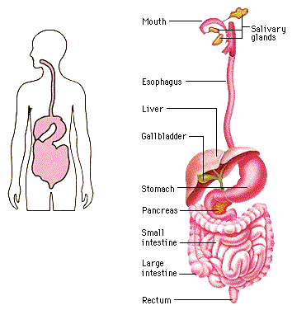
The Digestive System

Slide 5
Digestion
Two types of digestion:
Mechanical digestion—the food is broken down by chewing, mixing, and churning. There is no breaking of any chemical bonds!
Chemical Digestion—involves breaking chemical bonds using enzymes to make the food particles smaller.

Slide 6
Digestion
“Goals” of chemical digestion:
  Carbohydrates➔monosaccarides (glucose)
  Protein➔amino acids
  Fat➔fatty acids
Absorption—the moving of nutrients (glucose, amino acids, fatty acids) from the gut into the blood

Slide 7
Fun Facts
Chewing food takes from 5-30 seconds
Swallowing takes about 10 seconds
Food sloshing in the stomach can last 3-4 hours
It takes 3 hours for food to move through the intestine
Food drying up and hanging out in the large intestine can last 18 hours to 2 days!

Slide 8
Fun Facts
Americans eat about 700 million pounds of peanut butter.
Americans eat over 2 billion pounds of chocolate a year.
In your lifetime, your digestive system may handle about 50 tons of food!!

Slide 9
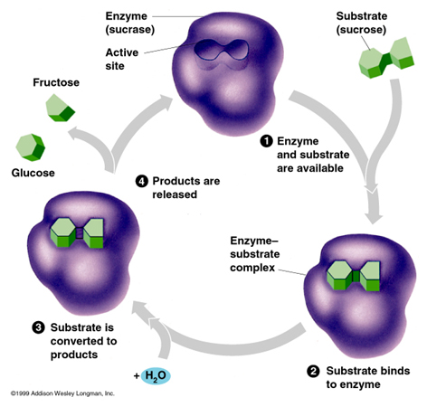
Enzymes in Digestion
Chemical digestion happens because of enzymes
Enzyme—a type of protein that speeds up the rate of a chemical reaction in your body.

Slide 10
Enzymes in Digestion
Amylase—an enzyme produced by glands near the mouth
  Breaks down complex carbohydrates (pasta, whole grain breads) into smaller sugars (glucose).
Pepsin—an enzyme that is produced in your stomach
  Helps in the chemical reactions that break down proteins.
Many other enzymes secreted by the pancreas that help to break down proteins, carbs, and fats.

Slide 11
Checkpoint!
How long is the small intestine?
  12 feet
  40 feet
  10 feet
  25 feet
2. Name three organs involved in digestion.

Slide 12
Checkpoint!
Chewing a piece of steak is an example of ____________.
  Chemical digestion
  Mechanical digestion
  Absorption
  None of the above.
4. Chemical digestion includes breaking ________ and using __________ to break down food.
A. chemical bonds, enzymes
B. Food particles, enzymes
C. Glucose, protein

Slide 13
Checkpoint!
Proteins are broken down into _________ before they can be absorbed.
A. Sugars
B. Fatty acids
C. Amino acids
D. Glucose
The enzyme produced in the mouth to break down carbohydrates.
A. Pepsin
B. Amylase
C. Lipase
D. Trypsin

Slide 15
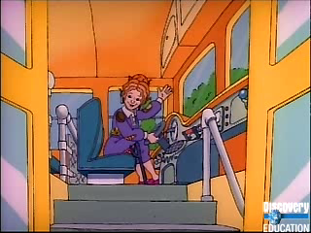

Slide 16
The Mouth
Teeth—purpose is to rip, grind, and mash food so it fits down our esophagus
Tongue—pushes food around mouth to make chewing and swallowing easier
Salivary glands—deliver saliva to the mouth. This fluid contains pancreatic enzymes to start breaking down carbohydrates.

Slide 17
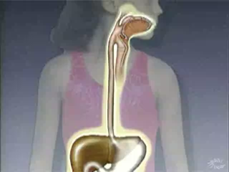
Esophagus
A muscular canal running from the pharynx to the stomach.
Peristalsis is the name used to describe the contract and release actions of this muscle to push food down to the stomach.

Slide 18
Stomach
Muscular “bag” to store, mix, digest, and empty food
Mechanical digestion: peristaltic waves contract throughout the stomach to mix and churn food
Chemical digestion: specialized cells in the walls of the stomach secrete HCl
HCl also helps to destroy bacteria in food

Slide 19
Stomach
Stomach also produces mucus which makes food slippery and protects the stomach
Two sphincters to help keep contents inside stomach
  Esophageal sphincter—top of stomach
  Pyloric sphincter—bottom of stomach
By the time food moves through your stomach, it is turned into a thin, watery liquid called chyme

Slide 20
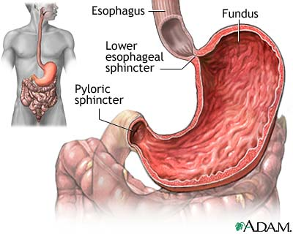

Slide 21
Small Intestine
First part of small intestine is called duodenum—most digestion takes place here
Bile from your liver is added into the duodenum
Acid from your stomach makes fat particles float to the top of the chyme
Bile breaks up the large fat particles to help begin digesting the fats

Slide 22
Small Intestine
Chemical digestion of carbs, proteins, and fats occurs when digestive solution from the pancreas is mixed in
The solution contains enzymes and also bicarbonate to help neutralize the stomach acid.
Absorption takes place in the villi of the small intestine

Slide 23
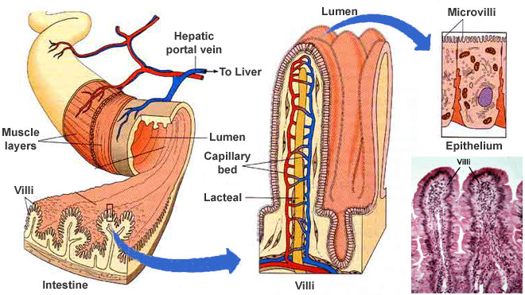

Slide 24
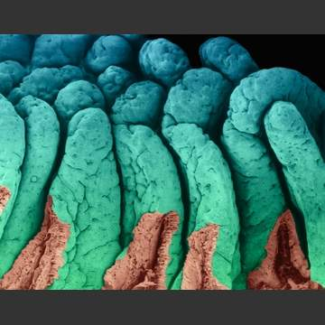

Slide 25
Small Intestine
Capillaries are within the villi of the small intestine
Nutrients (glucose, fructose, galactose, amino acids, and fatty acids) move into the blood through diffusion
HIGH CONCENTRATION TO LOW CONCENTRATION
The blood transports all the nutrients from the small intestine to the cells of your body

Slide 26
Large Intestine
Main job of the large intestine is to absorb water from the undigested mass
This helps to keep our body hydrated
The bacteria in your large intestine feed on undigested material and make vitamin K and two B vitamins
The dried up, undigested mass leaves the body through the rectum and anus

Slide 27
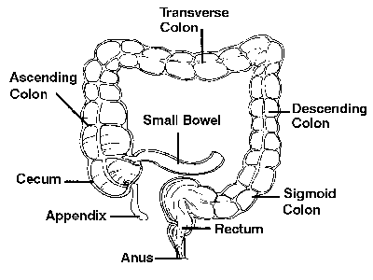

Slide 28
Secondary Organs Involved in Digestion
Food does not pass through these organs.
These organs make substances that help to aid in digestion.
  Liver
  Gall bladder
  Pancreas

Slide 29
Liver in Digestion
The liver produces bile which is then stored and made stronger in the gallbladder.
The bile is sent to the duodenum through a duct (common bile duct)
Bile emulsifies fats (separates it into small droplets) so they can mix with water and be acted upon by enzymes

Slide 30
Pancreas in Digestion
Pancreas produces pancreatic juice which empties into the small intestine through a duct.
The pancreas also produces insulin to help regulate blood glucose levels.

Slide 31
Pancreatic Juice
Contains sodium bicarbonate, which neutralizes the acidic material from the stomach.
Pancreatic amylase digests starches (starts in the mouth)
Trypsin and Chymotrpsin digest proteins—they are specific for certain proteins.
Lipase digests fats

Slide 32
Nutrition
Nutrients are substances in foods that provide energy and materials for cell development, growth, and repair.
Look for foods that are nutrient dense—foods that give you the nutrients you need with fewer calories
  Skinless, baked chicken vs fried chicken
  Fresh fruit vs fruit juice or fruit pastry

Slide 33
Energy Needs
Body needs energy for every activity it performs—beating heart, blinking your eyes, breathing, etc.
Energy comes from the food we eat—this energy is measured in calories.
Different foods contain different amounts of calories

Slide 34
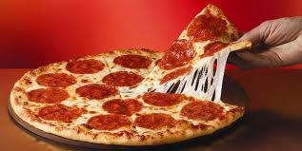
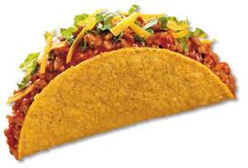
Caloric Content?
280 calories, 16 g PRO
186 calories, 15 g PRO

Slide 35
Checkpoint!
The liver produces ____________.
A. Pepsin
B. Pancreatic Juice
C. Bile
D. Kidney stones
2) Bile is sent through the ___________ to the _____________.

Slide 36
Checkpoint!
3) Pancreatic juice contains __________ to help neutralize acids from the stomach.
4) _________ is an enzyme from the pancreas that digests carbohydrates in the mouth.
5) This enzyme digests fats.
6) What is the job of bile? Where is it produced? Where is it stored?

Slide 37
Checkpoint!
7) What other function does the pancreas serve besides secreting pancreatic juice into the small intestine?
8) What are the two functions (jobs) of the large intestine?

Slide 38
Checkpoint!
9) Proteins are made up of subunits called ___________.
10) There are _________ of these subunits in the human body. __________ of which are essential (meaning they need to come from the diet)
11) What does nutrient dense mean?

Slide 39
Essential Nutrients
Proteins
Carbohydrates
Fats
Vitamins
Minerals
Water

Slide 40
Proteins
Large molecules that contain carbon, hydrogen, oxygen, and nitrogen.
Made up of a number of small units, called amino acids.
Body contains 20 amino acids—9 of which are essential because our bodies can’t make them.
We must get these from our diets.

Slide 41
Carbohydrates
The main source of energy for our bodies.
Made of carbon, hydrogen, and oxygen atoms.
Energy holds these atoms together, so when they are broken down, the energy is released for our body to use.

Slide 42
Carbohydrates
Simple carbohydrates—sugar, fruits, honey and milk
Complex carbohydrates
  Starch—potatoes, pasta
  Fiber—found in the cell walls of plants—whole grain breads, cereals, beans, fruits and vegetables all are good sources of fiber.
What does our body want to break carbohydrates into so we can use it for making energy?
  GLUCOSE!!

Slide 43
Fats
Also called, lipids, are necessary because they provide energy and help to store vitamins.
Fat also cushions your internal organs.
Excess energy from foods you eat is converted to fat and stored for later use.

Slide 44
Fats
Unsaturated fats (the “good” fat) —found in vegetable oils
  Polyunsaturated
  Monounsaturated
Saturated fats—found in meats, butter, fried foods, etc.
  Saturated fats raise the cholesterol levels in your blood. This can cause deposits on the arterial walls, causing heart disease and strokes.

Slide 45
Vitamins
Fat-soluble: Vitamins A, D, E, K, and “F”
Water-soluble: Vitamins B(B1, B2, B3, B5, B6, B7, B9, B12) and Vitamin C (citrus fruits)
http://www.ext.colostate.edu/pubs/foodnut/09312.html

Slide 46
Minerals

