Slide 1
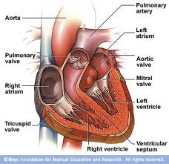
The Circulatory System

Slide 2
The Body’s Transport System
Like roads that link all parts of your town, your cardiovascular system links all the parts and systems of your body.
In one year, your heart pumps enough blood to fill more than 30 swimming pools!
A drop of blood makes the entire trip through your body in less than a minute.
Your heart beats about 100,000 times a day
A child’s heart is about the size of a fist. An adult’s heart is about the size of two fists.

Slide 3
Functions
Deliver Materials
  Blood ___________ chemical messengers, _______ from your lungs, and glucose from your digestive system to your body cells.
Remove wastes
  Takes away wastes from body cells. For example, blood transports _______________from body cells to you lungs, where it is exhaled.

Slide 4
Functions
Regulate Body Temperature
  Changes in the amount of blood flow in the skin helps carry heat way or prevents heat loss.
Fight Disease
  Blood contains cells that attack disease-causing

Slide 5
The Heart
The heart is a _________ that pumps blood to the body through the blood vessels.
The heart has a right side and left side that are separated by a wall of tissue called the septum.
Each side has two chambers.

Slide 6
The Chambers of the Heart
The upper chambers, called an _________, receives blood that comes into the heart.
Each lower chamber, called a ___________, pumps blood out of the heart.
The pacemaker, is a group of cells in the right atrium which send out signals that make the heart muscle contract.

Slide 7
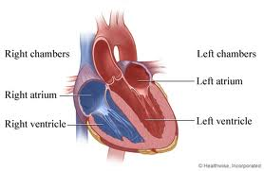

Slide 8
Valves of the Heart
Valves separate the atria from the ventricles.
A valve is a flap of tissue that prevents blood from flowing backward.
The ____________ valve separates the right atrium and right ventricle.
The ____________ valve separates the left atrium and left ventricle.
These valves are called AV valves (atrioventricular) because they separate the atrium and ventricle.

Slide 9
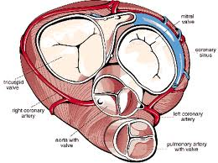
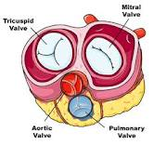

Slide 10
Checkpoint!
Explain why the contraction of the left ventricle must be stronger than the contraction of the right ventricle.
The ___________ sends out signals that make the heart muscle contract.
The __________ is the tissue that separates the left and right sides of the heart.

Slide 11
How the heart works
A heartbeat sounds like “lub-dup”.
First, the heart muscle relaxes, and the atria fill with blood.
Next, the atria contract, squeezing blood through valves.
Then the blood moves into the ventricles.
The ventricles contract. This contraction closes the AV valves, making the “lub” sound and squeezing blood into large blood vessels.
Finally, the valves between the ventricles and blood vessels snap shut, making the “dub” sound.
All this happens in less than one second!

Slide 12
Number the steps…
1.
2.
3.
4.
5.
6.

Slide 13
Pulmonary Circulation
In the first loop, blood travels from the heart to the _________ and then back to the heart.
This loop is very important because de-oxygenated blood is returned to the _______ to pick up oxygen.
This happens at the _________ in the lungs and oxygen is picked up by red blood cells because of the molecule ______________.

Slide 14
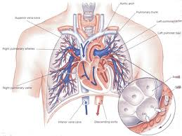

Slide 15
Systemic Circulation
The second loop, blood travels from the heart throughout the ______ and then back to the heart.
During this type of circulation, oxygenated blood is pumped to all the cells of the body.
This is important because the cells need the ___________ to combine with ___________ in a process called respiration in order to make ATP (_________!!).

Slide 16
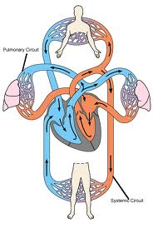

Slide 17
Coronary Circulation
Your heart is a muscle that needs energy to keep working.
Your heart has its own blood supply to bring the oxygen and glucose it needs for the cardiac (heart) cells to make ATP.

Slide 18
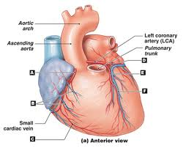

Slide 19
Blood vessels
___________ carry blood Away from the heart.
  Blood in the left ventricle is pumped in to the aorta the largest artery in the body.
From the arteries, blood flows into tiny vessels called capillaries.
  In the capillaries, substances are exchanged between the blood and body cells.
From capillaries, blood flows into veINs, which carry blood back _____ to the heart.

Slide 20
Extra: What color is your blood?
Blood is always red. Blood found in most of your arteries is bright red because it is rich in oxygen. Blood found in most of your veins is oxygen poor, so it is dark red in color.

Slide 21
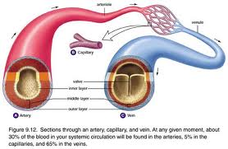
Blood Vessels
If blood vessels were hooked together, end to end, they would stretch a distance of almost 100,000 kilometers. That’s long enough to wrap around the Earth twice—with a lot left over!

Slide 22
Arteries
Arteries are thick-walled, muscular vessels that carry blood ________ from the heart to the body’s cells.
Arteries have three tissue layers
  The innermost layer is epithelial tissue that enables blood to flow freely.
  The middle layer is mostly smooth muscle tissue that relaxes and contracts, allowing the artery to widen and narrow.
  The outer layer is flexible connective tissue.

Slide 23
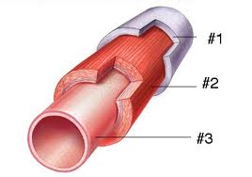
Arteries (Label the layers)

Slide 24
Veins
Veins are large vessels with walls thinner than artery walls that carry blood from the body cells back IN to the heart.
The walls of the veins have the same tissue layers as arteries, but the walls of veins are thinner than artery walls.
Veins also have _______ to prevent blood from flowing backwards.

Slide 25
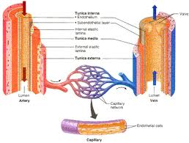

Slide 26
Capillaries
Tiny, thin-walled vessels where materials and wastes are exchanged between the blood and the body’s cells.
Capillary walls are only one cell thick! This allows for materials to pass easily between the walls.
Materials pass through the walls through diffusion.
Diffusion--molecules move from an area of higher concentration to an area of lower concentration.

Slide 27
Moving Blood
Blood flows into veins with little pumping force of the heart behind it.
The volume of blood from the capillaries collecting in veins helps to push along the blood ahead of it.
The contraction of skeletal muscles (through exercise and movement) helps push along the blood.
Larger veins have valves that keep blood from flowing backwards.
Breathing movements help force blood in the chest veins back toward the heart.

Slide 28
Blood Pressure
Blood exerts a force on the walls of the arteries.
The force with which ventricles contract causes blood pressure.
The first number, ________, is a measure of blood pressure when the ventricles contact.
The second number, _________, is a measure of pressure while the ventricles relax.
A typical blood pressure reading for a healthy adult is 120 over 80….120/80.
The blood pressure cuff the doctor uses is called a sphygmomanometer (sfig moh muh nahm uh tur).

Slide 29
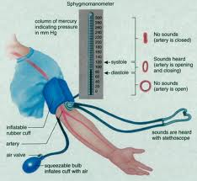

Slide 30
Composition of Blood
Blood has four components
Plasma
Red blood cells
__________________
Platelets
About 45% of the volume of blood is cells…the rest is plasma.

Slide 31
Plasma
Plasma is the liquid part of the blood.
Plasma carries nutrients, such as glucose, fats, vitamins, and minerals.
Plasma also carries away most of the carbon dioxide and many other wastes that cell processes produce.
Plasma also has three types of proteins:
  One group helps to regulate the amount of water in blood.
  The second group helps fight disease.
  The third group interacts with platelets to form blood clots.

Slide 32
Red Blood Cells
Red blood cells are produced in the bone marrow.
It is made mostly of hemoglobin, a protein that contains iron and binds to ___________.
When hemoglobin binds with oxygen, the cells become bright _______.
Mature RBCs have no nucleus, so it cannot reproduce or repair itself.
Mature RBCs live only about 120 days.

Slide 33
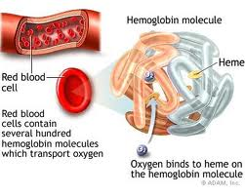

Slide 34
White Blood Cells
Also produced in the bone marrow.
They are the disease fighters.
White blood cells are larger and there are less than RBCs, about one white blood cell for every 500 to 1000 white blood cells.
WBCs have a nucleus and can live for days, months, or even years.

Slide 35
Platelets
Cell fragments that help form blood clots.
When a blood vessel is cut, platelets collect and stick to the vessel at the site of the wound.
The platelets release chemicals that produce a protein called fibrin.
Fibrin weaves a net of tiny fibers across the cut and platelets and blood cells become trapped in the net, and a blood clot forms.

Slide 36
Lymphatic System
As blood travels through the capillaries, some of the fluid moves into the surrounding tissues.
After the fluid gives the cells what they need, the fluid moves into your body’s drainage system, called the lymphatic system.
This network returns the fluid to the bloodstream.

Slide 37
Lymphatic System
Lymph—lymph consists of water and dissolved materials, like glucose. It also contains white blood cells that have left the capillaries.
Lymph nodes—filter lymph, trapping bacteria and other microorganisms in the fluid.

Slide 38
Cardiovascular Disease
Cardiovascular disease is the leading cause of death in the United States.
One out of every three teens has health issues that can lead to an increased risk of cardiovascular disease in the future.
Disease of the cardiovascular system include atherosclerosis and hypertension.

Slide 39
Atherosclerosis
(ath uh roh skluh roh sis)
A condition in which an artery wall thickens as a result of the buildup of fatty materials.
A thickened artery wall results in a reduced flow of blood, which causes a decrease in oxygen moving through the artery.
This can eventually lead to a heart attack which occurs when blood flow to part of the heart muscle is blocked, causing cells to die.

Slide 40
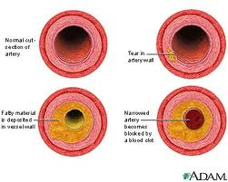

Slide 41
Hypertension
________ blood pressure
Healthy blood pressure is around 120/80
Usually higher than 140/90.
Hypertension causes the heart to work harder
Can cause damage to the blood vessels
Hypertension and atherosclerosis are closely related. As fat builds up, the arteries narrow, causing the blood pressure to increase.

Slide 42
Maintain a Healthy Cardiovascular System
To help maintain cardiovascular health, people should exercise regularly—60 minutes a day!
Eat a balanced diet that is low in saturated fats (butter, beef, cheese, fast food), trans fats (cookies, crackers, chips, processed foods), cholesterol, and sodium.
Do NOT smoke.
Smokers are more than twice as likely to have a heart attack as nonsmokers are!

Slide 43
Foods that come are pre-packaged are loaded with sodium and artificial ingredients.
These ingredients are high sodium content can eventually lead to hypertension

